Slide 1
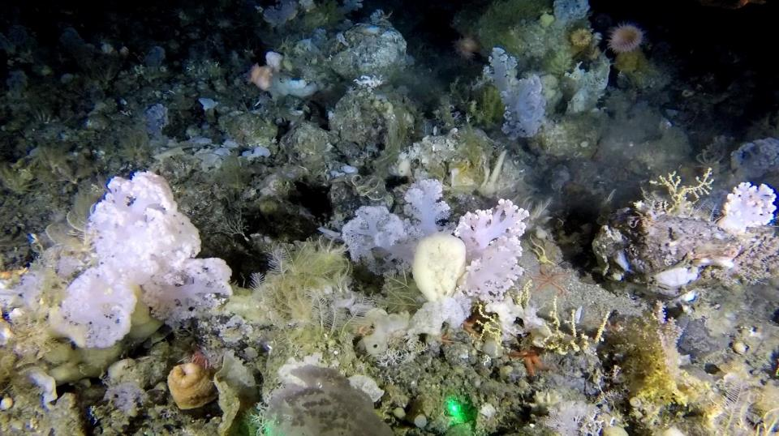

RVC WAB/WAH Field, Laboratory and Conservation Skills (FLCS) workshop:
Processing of benthic images
Stephen Long & Chris Yesson
Institute of Zoology, Zoological Society of London, 2023
London, UK

Slide 2
Overview
Why collect imagery?
How to collect imagery?
Practical: Play with the mini-towed camera sled
Example application of deep-sea towed camera sled in Greenland
How can we process imagery?
Practical: Have a go at processing imagery from Greenland in Biigle
Practical: Use the data to map soft coral distribution and density
Time-dependent
Practical: working with videos instead of images, an example from Cornwall

Slide 3
Why conduct image based surveys?
Cost-effective
Monitor cryptic fauna
Powerful outreach/communication resource
Access hard to reach environments
Safety
Repeatable in time and space

Slide 4
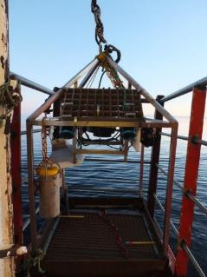
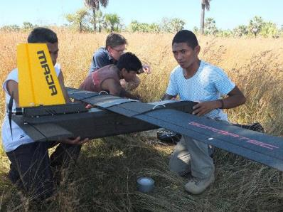
How to collect imagery?
Remote sensing (satellites, drones)
Camera traps
Citizen scientists
Mounted on study species
Remote operated vehicles (marine)
Towed cameras (marine)

Slide 5
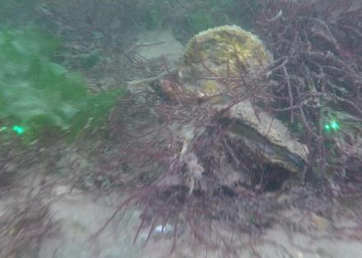
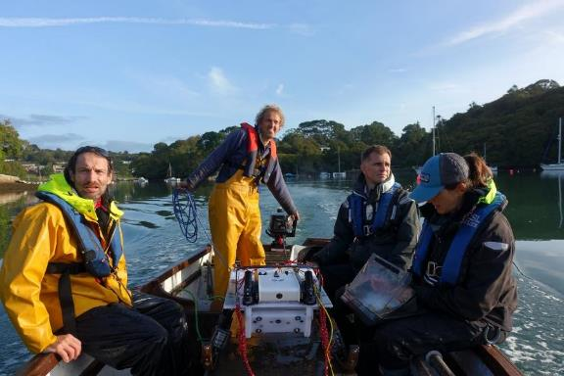
Towed camera sled
Examples of marine camera systems

Slide 6
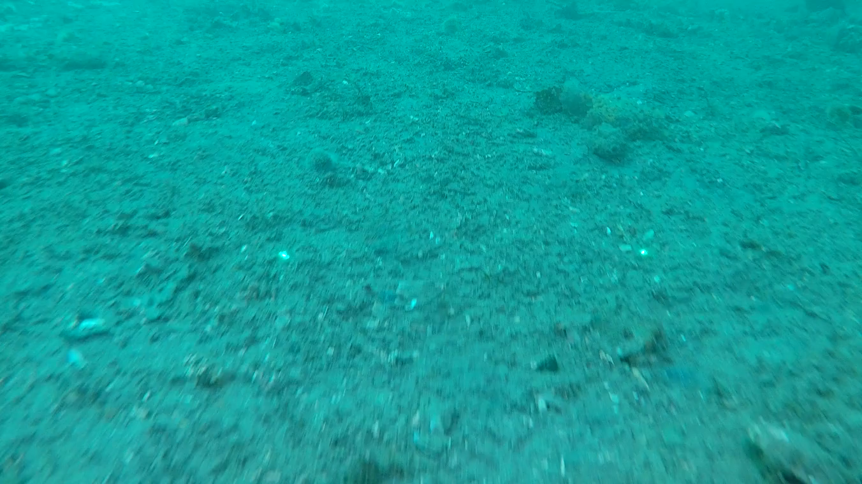

Slide 7
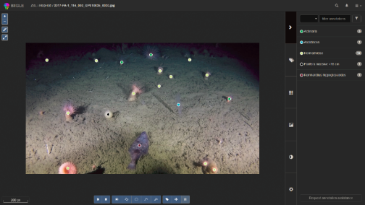
But how can we process imagery?
Storage of imagery and annotations
Stills or videos?
Experts? Citizen scientists? AI? Combination?
Quality control/revision
Software platform (our solution is Biigle…)
Scale
Reproducibility
Next step…
-> let’s go to Greenland
-> collect some imagery
-> process the imagery
-> use the data
Notes:
Deep sea 101:
Dark, cold, slow, pressure increases by 1 atm every 10m

Slide 8
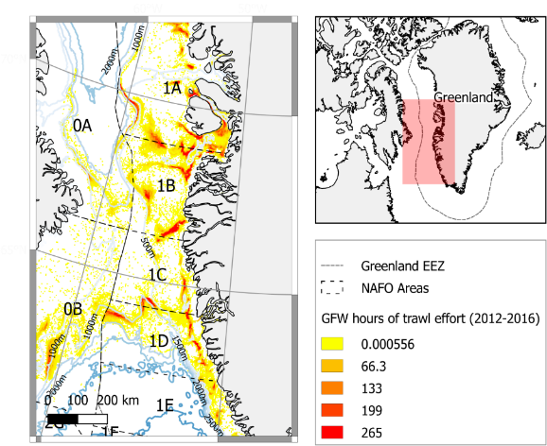
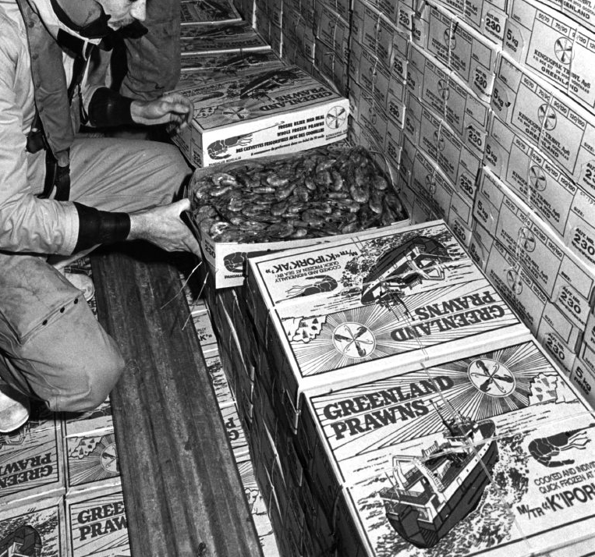
West Greenland
Fishing accounts for 90% of Greenland’s foreign exchange earnings
Majority from two deep-sea fisheries
But little is known about the nature of the habitats or how they are impacted

Slide 9


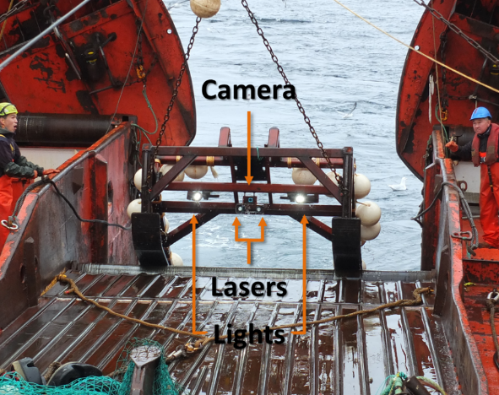
@Stephen_D_Long
Notes:
Blue Planet imagery on ZSL budget

Slide 10
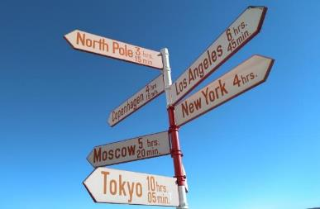
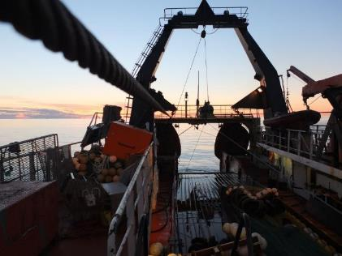
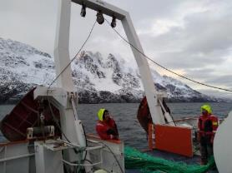
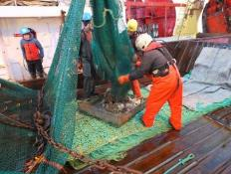
A 45 second deep-sea field trip…
@Stephen_D_Long
Notes:
Deployment video

Slide 11

Notes:
Deployment video
Don’t forget to submit your expenses!

Slide 12
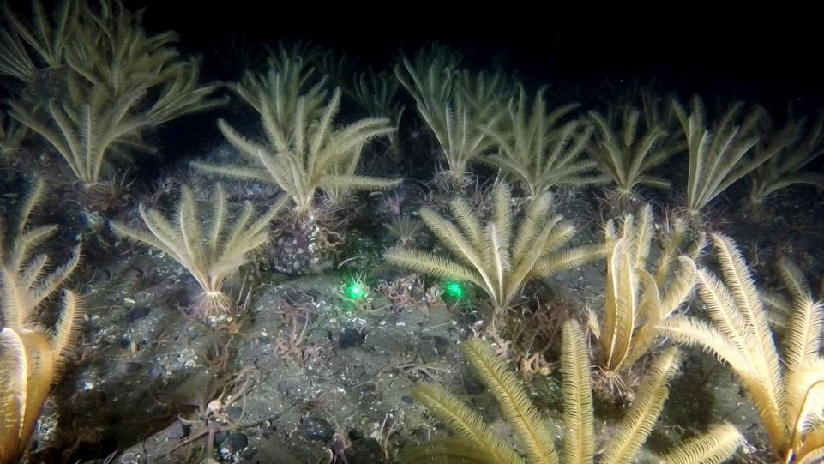

Slide 13
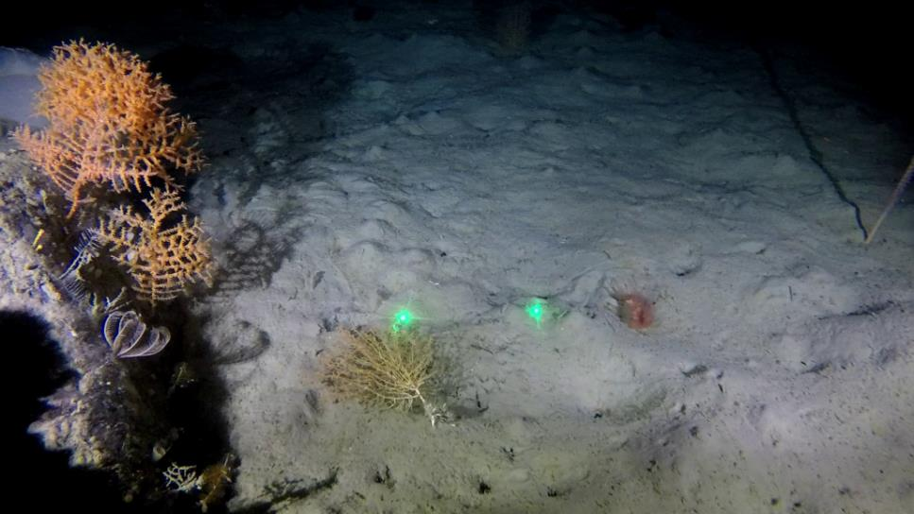
Notes:
Four species of coral
All with fragile calcium skeletons growing mm a year, so recovery is decades to centuries

Slide 14
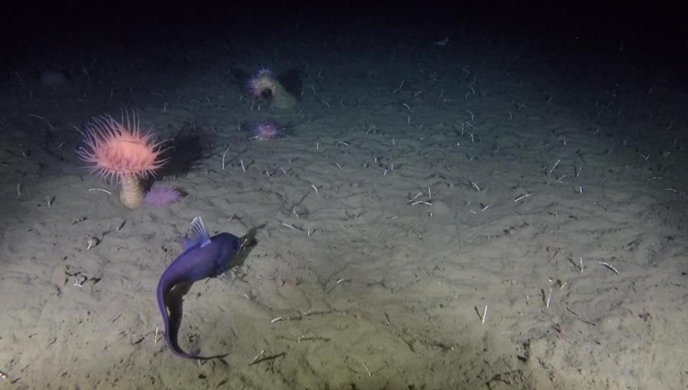

Slide 15
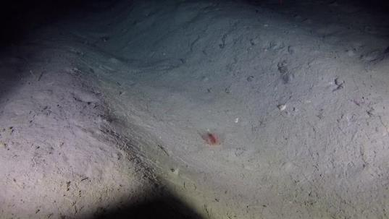
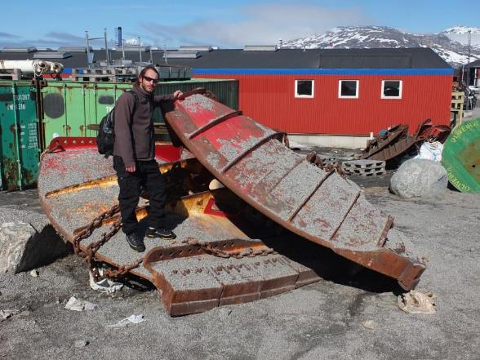
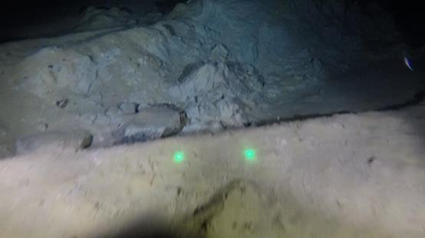
Physical evidence
of trawling down to 1,400m

Slide 16
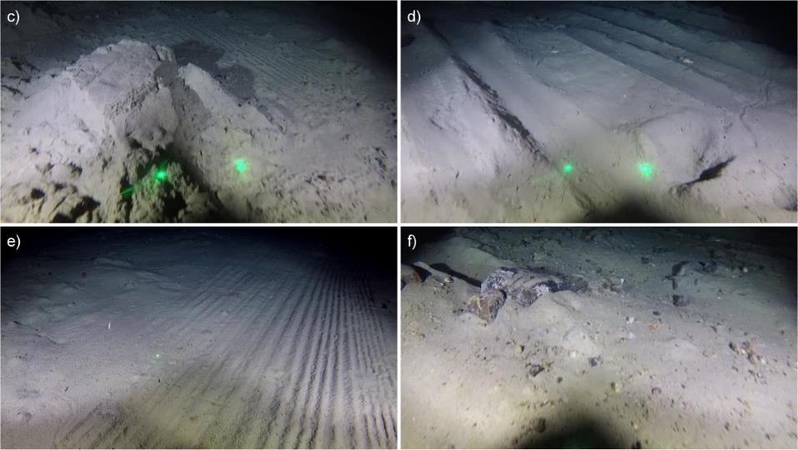
Physical evidence of trawling

Slide 17
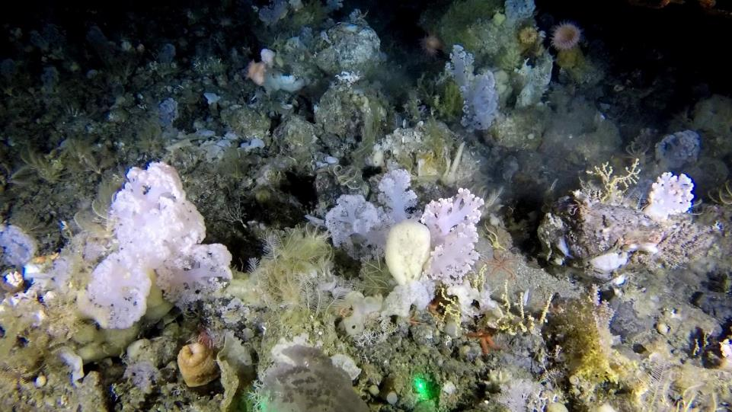

Slide 18

Practical: Using Biigle to annotate imagery
In a subset of 11 images (from three different tows) annotate:
Fauna
Substrates
How can we quality control annotations?
Use Largo tool to review annotations of cauliflower corals.

Slide 19
Practical: Using Biigle to annotate imagery
Biigle logins:
ZSL Trainee 1, benthichabitats@gmail.com
ZSL Trainee 2, habitatsbenthic@gmail.com
ZSL Trainee 3, cyesson@gmail.com
ZSL Guest, greenlandhabitats@gmail.com
Password: CoralGarden123
Github: https://github.com/cyesson/Training/tree/master/BenthicImageProcessing
(Google: ‘Chris Yesson git’)

Slide 20
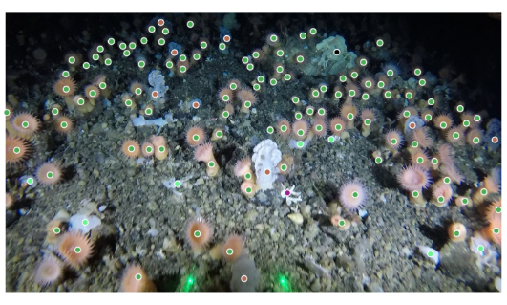
Link to our annotation of these stations
2018_SA_11_086_GP060022_I0006_T02-56_Sled.jpg
Completed annotation: https://biigle.de/images/620972/annotations?r=264&x=1352&y=760

Slide 21
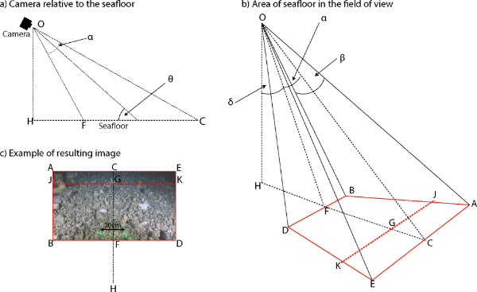
Practical: Use annotation data to make a map
What can we do with the data?
How to translate annotation into maps of distribution and density?
What metadata do we need to have collected in the field to ensure the imagery is useful?
In R:
Open csv of the estimated density of cauliflower corals at 18 stations
Produce a map showing their distribution and abundance

Slide 22
Find out more:
https://www.frontiersin.org/articles/10.3389/fmars.2020.00460/full

Slide 23
Practical: Annotating videos
Annotate sections of video to differentiate between patches of habitat
Use the JNCC’s Marine Habitat Classification for Britain and Ireland
https://mhc.jncc.gov.uk/
Annotate the spider crabs
Are spider crabs associated with a particular habitat?

Slide 24
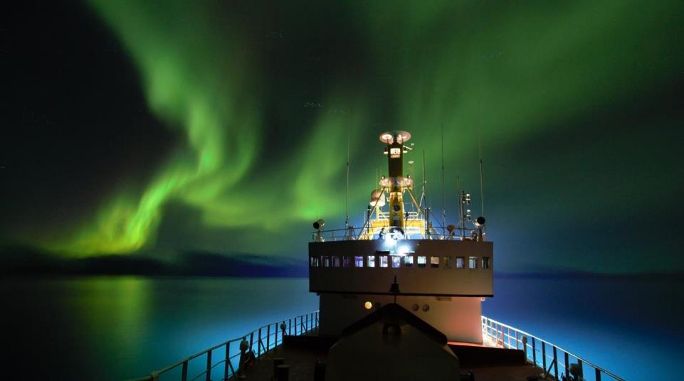
Thank you

Slide 25
